Slide 1
MAZE DUNGEON GAME
Group 2
Members
Abigail Kariuki- 150470
Ayushi Savla- 149588
Daniella Iseu- 150878
Mwenda Mugambi- 150476
Victoria Mwaura-149998

Slide 2
—SOMEONE FAMOUS
"Life is a maze, but every twist and turn brings you closer to the exit—keep going!"

Slide 3
INSPIRATION
The project was inspired by the Pac-Man game.

Slide 4
The Pac-Man Game
Pac-Man is an arcade video game where players must navigate through complex mazes filled with obstacles, enemies, and traps.
The goal is to eat all dots while avoiding dangers like moving enemies.
The game often features a time element or challenges that increase in difficulty, requiring quick thinking and strategic movement to escape the maze.
The concept is inspired by a pizza without a slice .

Slide 5
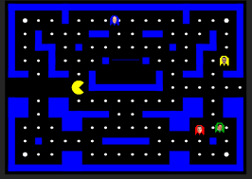
Pac-Man

Slide 6
OUR GAME
Maze Dungeon
Life is a maze
In our game, the player goes underground through a dungeon. As he descends into the earth, their aim is to collect as many treasures while simultaneously avoiding the moving bombs before time runs out.

Slide 7

PROJECT OVERVIEW
GAME FEATURES
CODE OVERVIEW
PROJECT DOMAIN
WebGL application
What exactly is on our game.
Building the game

Slide 8
GAME FEATURES
MAZE UI
USER CONTROLS
TIMING
MOVING BOMBS
Move through the maze to play
Control user movements with the keyboard
Collect treasures before time runs out
Avoid the moving bombs to avoid death
LEVELS
TREASURES
SCORE KEEPING
Incremental levels with increased difficulty
These help you boost your score
Keep a record of user scores as the game proceeds

Slide 9
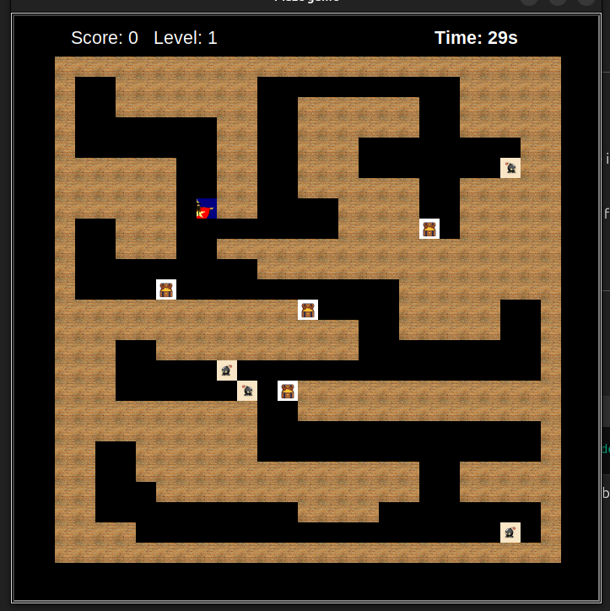
Game appearance

Slide 10
CODE OVERVIEW
Project Description: Maze Dungeon Game is an interactive game where players navigate through a maze to collect treasures as they try to dodge bombs to reach the goal.
Frontend:
UI Elements designed for intuitive gameplay.
Player interactions rendered dynamically based on game progress.
Backend Logic:
Game mechanics implemented in Python with focus on:
Maze generation algorithms.
Player movement and collision detection.
Scoring and state management to track progress.
Dependencies:
Core libraries: pygame for graphics and user interaction.

Slide 11
Project Repository
https://github.com/Ayushi-Savla/maze_dungeon_game

Slide 12
REQUIREMENTS
INSTALLATION:
How can you install the game on your machine?
Ensure you have Python installed (Python 3.12 is recommended).
The game requires the following Python modules:
math (built-in)
Pygame (built-in)
random (built-in)
turtle (built-in)
Ensure you are running a Python version that supports these modules.

Slide 13
INSTALLATION
Clone the repository:
git clone https://github.com/Ayushi-Savla/maze_dungeon_game
Navigate to the project directory:
cd maze_dungeon_game
Install the required dependencies:
pip install -r requirements.txt

Slide 14
RUN THE GAME
Run the following command in the terminal to start the game:
python main.py

Slide 15
OUR TEAM
150878
149588
150476
149999
150470
Daniella
Iseu
Ayushi
Savla
Mwenda Mugambi
Victoria
Mwaura
Abigail
Kariuki

